Slide 1
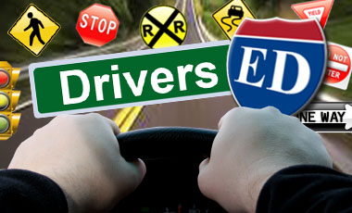
Driver Certification Training
University of Dayton
Environmental Health and Safety

Slide 2
Agenda
Part I: Review of UD Driver Certification Policy
Part II: Defensive Driving Techniques
Part III: Van Safety
Part IV: Utility Vehicle Safety

Slide 3
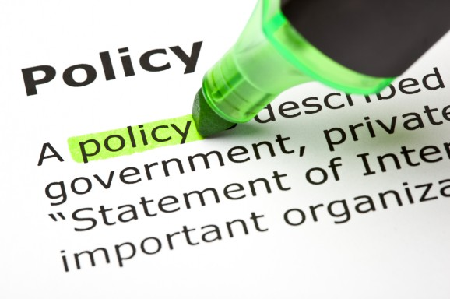
Part I: Review of UD Driver Certification Policy

Slide 4
UD Driver’s Certification & Vehicle Usage Policy
The Vehicle Use and Driver Certification Policy is established as part of the continuing efforts to improve the safety of University faculty, staff, students and volunteers who operate University-insured vehicles, to reduce the risk of injury and/or loss to the University, and to enhance University insurability.
University-insured vehicles include golf and utility carts, leased or donated and rental vehicles.

Slide 5
Policy States
All University faculty, staff, students and volunteers who plan to drive a University-insured vehicle for University business-related operations and sponsored events are required to complete the Driver Certification session ANNUALLY.
UD-insured vehicles include golf and utility carts, leased or donated and rental vehicles.

Slide 6
Driver Certification
By completing this certification and maintaining a current state-issued driver's license with a non high-risk record, you are eligible for certification.
It is your responsibility to maintain your driver's certification by maintaining your current license and by renewing the certification annually before it expires.
If the status of your driver’s license changes, you must notify your supervisor and the Office of Risk Management and Insurance at 937-229-4502.
International licenses are not eligible for the certification process. A license from the United States must be obtained.

Slide 7
Other Circumstances
Drivers involved in an at-fault accident will be instructed to re-take the online driver’s certification and might be suspended from driving until the investigation of the accident is completed.
For at-fault accidents, there will be a $500 deductible charged to the associated department, club or organization.

Slide 8
Privileges may be denied
High Risk - MVR (Motor Vehicle Record) check through the Bureau of Motor Vehicles reports violations and/or a suspended or invalid license. All who have high risk violations and/or accidents on their records will not have coverage.
Reporting – Failure to report an accident according to the Office of Risk Management and Insurance reporting procedures may result in loss of driving privileges.

Slide 9
Accidents
Following an accident with a University-insured vehicle:
Immediately notify the local law enforcement agency (police) for that location. If the accident occurs on campus, notify University of Dayton Public Safety at (937) 229-2121.
Notify the Office of Risk Management and Insurance regarding accidents or any vehicle damage within 24 hours, preferably before you leave the scene, at:
(937) 229 - 4502, Monday-Friday, 8:00 a.m. to 5:00 p.m.
(if after hours, please leave a voice mail message)

Slide 10
Rentals
When renting a vehicle for University business, note that UD Purchasing has made an agreement with Enterprise & National Rental. Use Contract ID XZ38Y40 when making your reservation to receive extra benefits including the collision/ loss damage coverage.
The UD rental contract can only be used for UD business and UD-sponsored events, not personal use.

Slide 11
Rentals (cont’d)
If you are in an accident while operating a rental, call the 800 number on the back of your contract and also contact the Office of Risk Management and Insurance to report the accident.
For your rental, obtain a UD insurance card from your supervisor or contact the Office of Risk Management and Insurance at (937) 229-4502.

Slide 12
Additional Information
UD vehicles (golf and utility carts, leased or donated and rental vehicles) are not for personal use or non-UD-related business, unless the vehicle is personally-assigned exclusively to the individual.
Insurance follows the vehicle, if you choose to use your personal vehicle for UD business, your insurance coverage is primary in the event of an accident.
When using a University vehicle, obtain a contact name and phone number from the department who manages the vehicle. They will advise you in the event of mechanical trouble.

Slide 13
Additional Information (cont’d)
All persons riding in a UD-insured vehicle MUST wear their seatbelt at all times when the vehicle is in motion.
Personal property IS NOT insured by the University. Personal belongings should be insured through your own insurance.
In an effort to enhance safety, 15 passenger vans can only be loaded to a capacity of 12 people including the driver.

Slide 14
Additional Information (cont’d)
Smoking is prohibited in University-owned vehicles.
Texting (writing, sending or reading text messages) while driving a UD-insured vehicle is prohibited. Ohio has an official ban on texting while driving; you can be ticketed.
Talking on the cell phone while driving is illegal in some states. Although not illegal in Ohio, hands-free cell phone operation is preferred over hand-held usage. Due to increasing liability, the University asks that you refrain from all cell phone usage while driving a UD insured vehicle. Please pull over and park to make a call.

Slide 15
Additional Information (cont’d)
Usage of earphones is prohibited in UD insured vehicles, including carts and utility vehicles.
The University DOES NOT pay for your traffic tickets. If you receive a ticket, including parking tickets, while using a University-insured vehicle, it is YOUR responsibility to pay the ticket in a timely manner.

Slide 16
Additional Information (cont’d)
In the State of Ohio you must have "Proof of Insurance" with you at all times when operating a motor vehicle. This information is located in the glove box of all UD-insured vehicles. You may be issued a citation for not having proof of insurance. Please be certain that the insurance card is in the glove box of the vehicle before you begin your journey.
Insurance cards can be obtained from the Office of Risk Management and Insurance by calling (937) 229-4502.

Slide 17
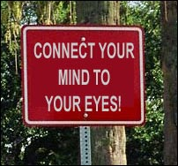
Part II: Defensive Driving Techniques

Slide 18
Defensive Driving Overview
Leading contributors to car crashes include:
Distracted driving (largest contributor)
Speeding
Driving while impaired
Other common contributors to car crashes include:
Driving too fast for conditions
Following too closely
Going over the center line
Techniques to help you drive defensively include:
Anticipate actions of other drivers.
Avoid dangers posed by poor road and weather conditions.

Slide 19
Get Ready!
Vehicle malfunction is one of the most common causes of crashes.
A pre-trip inspection may help avoid a crash or breakdown.

Slide 20
Pre-Trip Inspection Suggestions
Walk around the vehicle: check for damage, leaks and loose parts.
Open hood: check fluid levels.
Check wiper blades: wipe with cloth, replace if worn.
Inspect tires for reasonable wear, proper inflation and loose or missing lug nuts.
If hauling, secure the load.

Slide 21
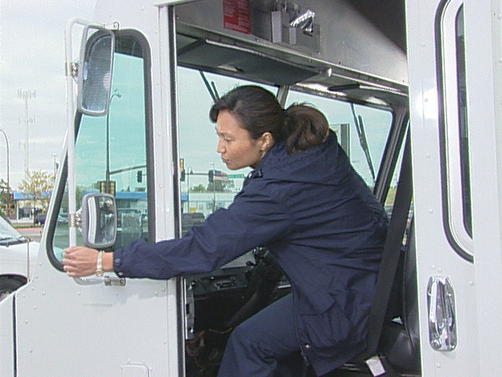
Pre-Trip Inspection Suggestions (cont’d):
Start engine; listen to how it sounds.
Make sure lights, turn signals and windshield wipers work properly.
Safety store loose items that may be on the floor and/or dashboard.
Adjust all mirrors.
Fasten seatbelt.

Slide 22
Stay Focused
Driving is the most dangerous thing most people do on any given day.
Most crashes involve someone who is distracted or inattentive.

Slide 23
Common Distractions
Eating and drinking
Using hand-held cellular phone
Selecting music
Watching GPS system
Daydreaming
Talking with passengers

Slide 24
Be Aware
Keep scanning entire field of vision.
Don’t look at any object too long.
Check mirrors every 5 to 8 seconds.
Adjust mirrors to minimize blind spots.

Slide 25
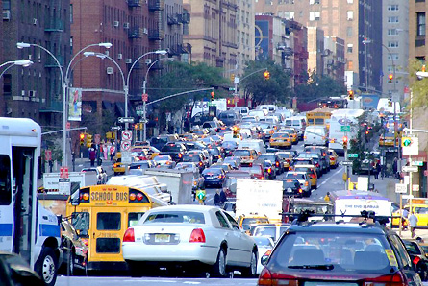
Look Ahead
The road ahead can hold potential hazards.
You will need time to see and then react to them.
How Far Ahead?
On open highway:
Try to see approximately ½ mile ahead.
In congested areas:
Try to see approximately 1½ blocks ahead.

Slide 26
Prepare To Stop
Watch traffic lights; gauge when they are going to change.
Pay attention to brake lights on vehicles in front of you and in front of them.
If car ahead brakes hard, slow down immediately and be ready to stop.

Slide 27
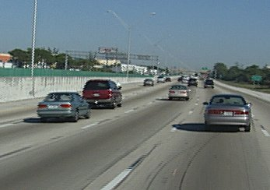
Back Off
Following too closely results in thousands of crashes each year.
If the driver in front of you brakes, you will need to be able to stop quickly.

Slide 28
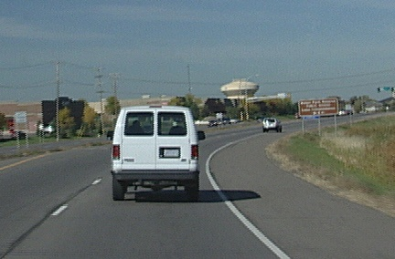
Determining Following Distance
Find a fixed object in the distance to begin your test (such as a sign or telephone pole).
When the vehicle ahead of you passes the object, count until your vehicle passes the same object.
Allow 3 seconds if traveling at 40 mph and add 1 second for inclement weather, unsafe conditions or increased speed.

Slide 29
Common Mistakes
Driving continually in left lane
Failing to use turn signals
Turning improperly on red light
Merging incorrectly
Failing to yield

Slide 30
Common Mistakes (cont’d)
Carelessly backing up
Running red lights
Cutting in and out of traffic
Driving while distracted

Slide 31
Stopping Along The Road
Pull off road as far as possible.
Turn on emergency flashers right away.
If possible, call to get help.
Exit vehicle only when safe to do so.

Slide 32
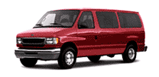
Part III: Van Safety

Slide 33
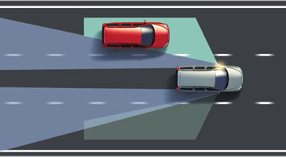
Differences Between a Van and a Passenger Vehicle
Vans have larger blind spots
Vans are heavier than a car which causes them to accelerate more slowly and require a longer stopping distance
Vans are wider, longer and higher
Vans have a higher center of gravity, which causes them to tip more easily.

Slide 34
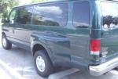
More differences
Opposed to a car, the van driver’s position over the front wheels changes his/her perspective of the driving environment.
The overhang of the van is important to consider when backing.

Slide 35
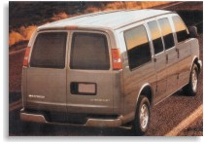
Backing up
When backing up, scan the area for obstacles below and above the van
Use a spotter
Back slowly and use your mirrors

Slide 36
UD Guidelines for Vans
All UD passenger vans are only permitted to carry a capacity of 12 total occupants, including the driver.
Recommendation of at least two certified drivers on any trip over 2 hours.
Travel should be suspended if the National Weather Service has issued a traveler’s advisory or predicts severe weather.
Every passenger and driver must wear a properly adjusted safety belt any time the van is moving.
All equipment must be stored completely under the seats or in the back of the van.

Slide 37
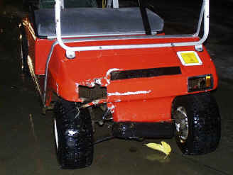
Part IV: Utility Vehicle Safety

Slide 38
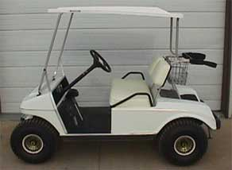
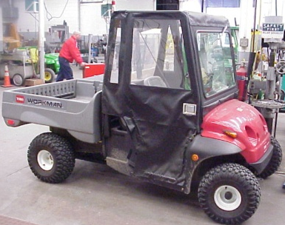
Types of Utility Vehicles
Golf Carts
Gator Vehicles
Toro Vehicles
Kubotas
Riding Mowers

Slide 39
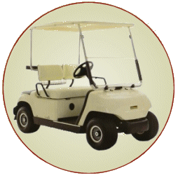
Carts and Cars, What’s the Difference?
Carts roll easier
Carts operate more closely to pedestrians
Carts run silently
Other motor vehicles have the right-of-way
Pedestrians have the right-of-way.

Slide 40
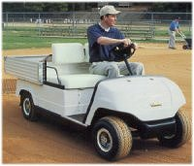
Carts vs. Cars (cont’d)
Center of gravity is lower than most vehicles
Speed limit is MUCH lower – 5 mph on campus

Slide 41
UD Guidelines for Use of Carts
Applies to all operators of low speed vehicles, electric or gas powered, on UD Campus.
All users must have a current/valid driver’s license in their possession and must complete the online Drivers Certification session through EHS/RM.
All drivers must be trained in cart operation by their supervisor or department designee.
All drivers operating carts must comply with applicable traffic laws.
Drivers are responsible for understanding and complying with the manufacturer’s operating recommendations.

Slide 42
Cart Safety Guidelines
Obey ALL traffic signs
Do not exceed cart weight capacity
Sudden stops or changes in direction may result in loss of control
Keep hands and feet inside at all times when cart is moving
Avoid tipping over – drive straight up or down a slope
Always remain seated
Slow down before and during turns
Reduce speed, use extra care in inclement weather

Slide 43
Cart Safety Guidelines (cont’d)
Stop for pedestrians - pedestrians always have the right of way
Drive slowly

Slide 44
Thank You For Viewing the Presentation
Note that before you are certified to operate a UD-insured vehicle, golf cart or rental:
You must pass the quiz following this presentation.
Sign and submit the Certification Form.
After you pass the quiz and submit the signed form, the Office of Risk Management and Insurance will order your Motor Vehicle Report (MVR). This process takes approximately seven days after receiving your submittals. If approved, you will receive a certificate by e-mail noting your certification and expiration dates. If not approved, you will be informed.

